Slide 1

GO4LUNCH
Android application to find and invite your co-workers to lunch

Slide 2
Displaying the list of restaurants
In order to display the list of restaurants to the user, first we get any local places via Googles ‘Place Detection client’
Once we have defined the PlaceDetectionClient we get the results of the response and store this in a reference variable of type “PlaceLikelihoodBufferResponse”
Now we have the response, we loop through each PlaceLikelyhood and filter against the following place types
PlaceDetectionClient mPlaceDetectionClient = Places.getPlaceDetectionClient(getApplicationContext(), null);
likelyPlaces = task.getResult()
if (placeType.contains(com.google.android.gms.location.places.Place.TYPE_RESTAURANT) || placeType.contains(com.google.android.gms.location.places.Place.TYPE_BAR) || placeType.contains(com.google.android.gms.location.places.Place.TYPE_CAFE) || placeType.contains(com.google.android.gms.location.places.Place.TYPE_FOOD)) {

Slide 3
Displaying the list of restaurants
If the place type of the returned PlaceLikelyhood place matches our IF conditions
We then call the method
addMarkersToMap(Place place)
First, we define a marker and set its position and title
final Marker marker; MarkerOptions mOptions = new MarkerOptions() .position(place.getLatLng()) .title(place.getName().toString());
Then we set the icon of the marker, in this case it is a custom drawable. We then use our reference to GoogleMaps to add a marker, passing the marker options and set the tag which is used to determine if a marker is selected or not
mOptions.icon(BitmapDescriptorFactory.fromResource(R.drawable.marker_orange)); marker = mGoogleMap.addMarker(mOptions); marker.setTag(MARKER_UNSELECTED);

Slide 4
Displaying the list of restaurants
At this point the Map view (google map) will have the marker we just created added.
The next step in the addMarkersToMap method adds the newly added marker to an array List of markers so we can keep track of all the markers we have added
The final step in this method, uses the google place we passed to the method to create a plain old java object of the place.
allMarkers.put(marker.getTitle(), marker);
PojoPlace pojoPlace = new PojoPlace(place, null);
Continued…

Slide 5
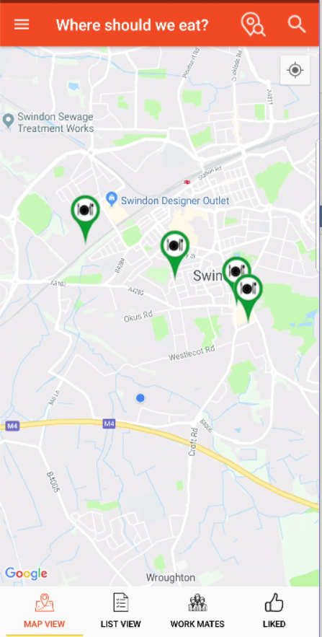
Displaying the list of restaurants
mPlaces.put(pojoPlace.getName(), pojoPlace); originalPlaces.put(pojoPlace.getName(), pojoPlace); findPlacesResponse(false); //No error so we can respond by just hiding the UI components displayed while searching. Also animates the camera refreshMarkers(); //now we have added the new place, refresh the markers
We add the new pojo place object to a HashMap that keeps track of all the place of the map.
We also add the place to originalPlaces HashMap which is used in the search filter.
Finally we respond to the event by hiding the UI components displayed while finding a place and finally we refresh the markers on the map

Slide 6
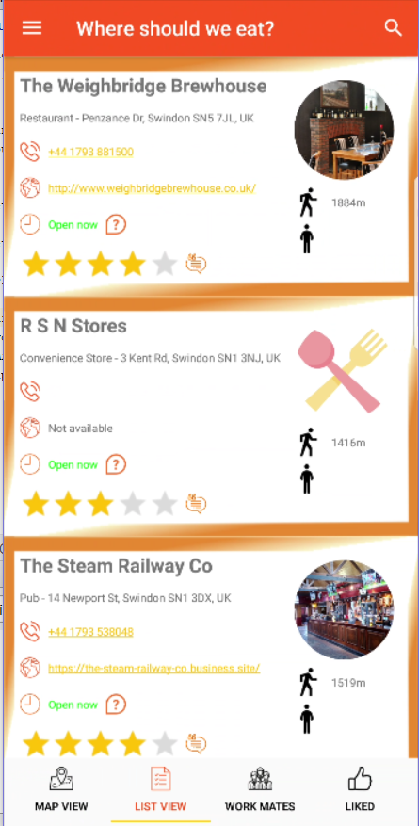
Displaying the list of restaurants
At this place point in the code, we now have a list of places in the system and these places are also represented by markers on the map.
We can then create the recyclerview adapter for the ‘list view’ using our list pojoPlaces.
Each place corresponds to 1 entry in the recycler view. Showing the details of
Place name
Place type and address
Phone number
Website
Opening hours and times
Rating and reviews
Distance to the place
Number of friends eating at this place
An Image of the place

Slide 7
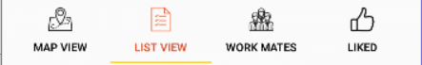
The fragments
The application contains 4 fragments representing the different tabs and 1 base fragment.
The base fragment implements our firebase callback interface in order to receive data from the database.
Each of the 4 fragments extends the base fragments and implements the methods required

Slide 8
The fragments
This fragment displays the map and any markers

Slide 9
The Fragments
This fragment displays a recyclerview listing all the places corresponding to the markers on the map

Slide 10
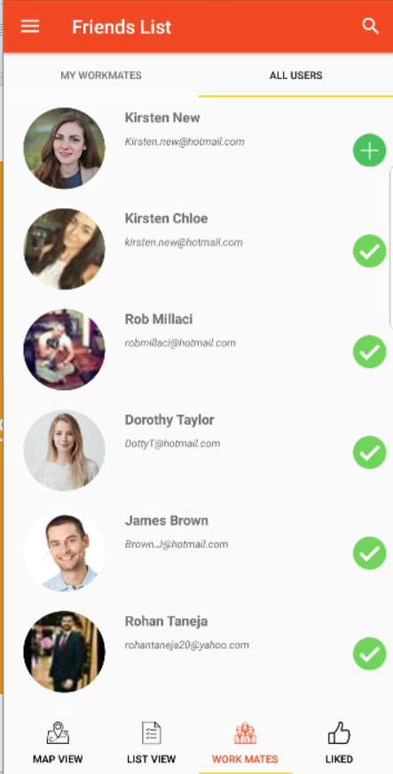
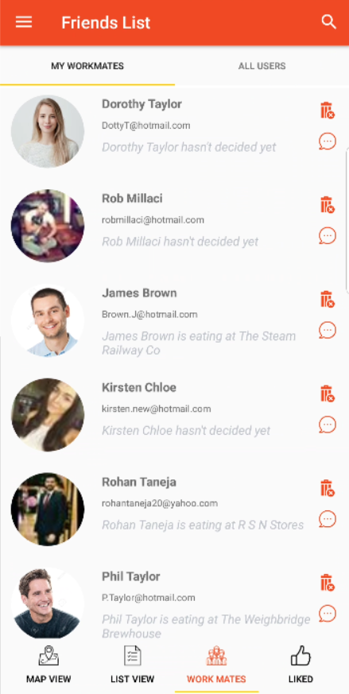
The fragments
Displays the list of all users in the system and a list of those users that have been added as friends

Slide 11
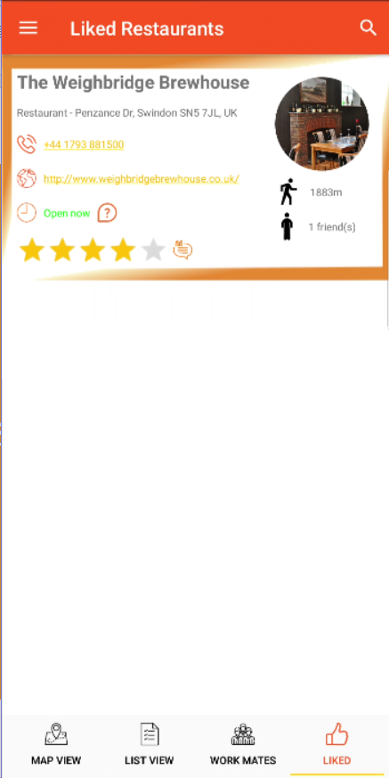
The fragments
The last fragment displays any places that have been ‘liked’ by the user

Slide 12
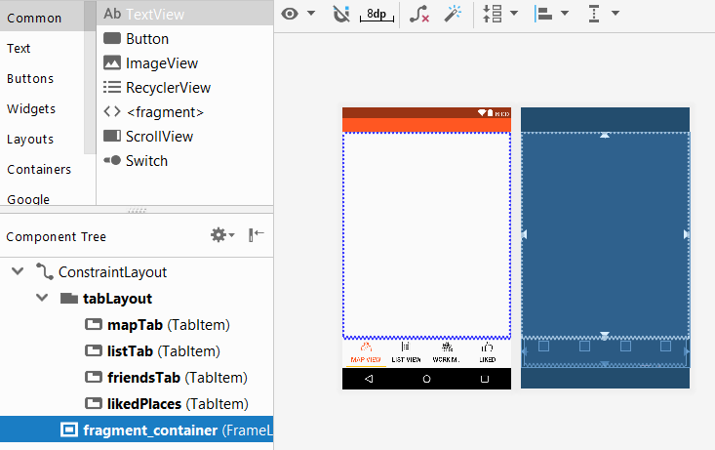
Managing the fragments
In order to display the relevant fragment to the user, depending on which tab is selected, I have added a ‘Frame Layout’ to the res file for the.
This Frame layout will be used to hold the different fragments and display them to the user

Slide 13
Managing the fragments
Each of the above tab icons have an on Click listener attached.
Depending on the tab selected the click events will do the following
Update the UI (changing the icons from orange(selected) to black (unselected)
Call the ‘createFragment()’ method depending on which tab is selected.
For example, clicking on ‘List View’ will call createRestaurantListFragment() which will execute the following code
This will replace any fragment contained in the Frame layout we saw in the previous slide, displaying the new fragment to the user
final RestaurantListFragment listFragment = new RestaurantListFragment(); FragmentManager manager = this.getSupportFragmentManager(); FragmentTransaction transaction = manager.beginTransaction(); transaction.replace(R.id.fragment_container, listFragment, RESTAURANT_LIST_FRAGMENT); transaction.commit();

Slide 14
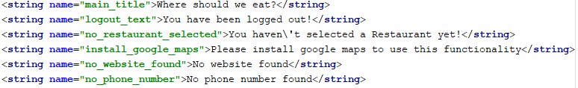
Multi language display
Each piece of text displayed to the user in this app is stores in the Strings resource directory
Android resolves language- and culture-specific resources based on the system locale setting. It is therefore possible to create another strings resource for a defined country code which android will use when detecting a new locale (in this case we are translating the application to Spanish (es)
The next slide will look at the Spanish strings resources

Slide 15
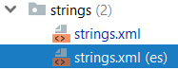
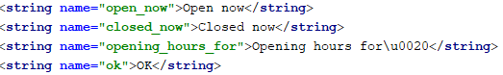
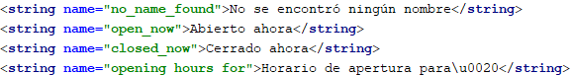
Multi language display
As stated previously, we have defined a strings resources file for our application, containing all text entries in the application.
In order to successfully translate the app, I have created a new Strings resources file for the country code es (Spanish)
This resources file contains all the strings in the standard strings res file, but the text has been translated to Spanish. Therefore on an ‘es’ device, when android resolves the getText(R.String.’text resource name’), it will return the Spanish version

Slide 16
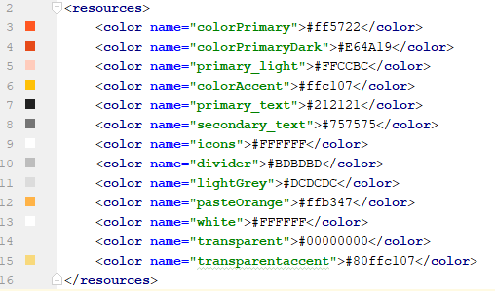
The Theme - Colours
For the applications theme, a number of colours have been defined in the application
This is used to ensure that each view in the system have the same colour scheme which enhances the UI and follows the principle of material design

Slide 17
The Theme - Styles
As well as defining colours, a number of Styles have been defined and set to activities as below
Main activity –
Chat activity –
Restaurant activity –
Reviews activity –
Start activity -
The next slide will look at the 3 different styles we have defined
@style/AppThemeInvisibleStatusBar
@style/AppThemeVisibleStatusBarWithActionBar
@style/AppThemeVisibleStatusBarNoActionBar
@style/AppThemeVisibleStatusBarWithActionBar
@style/AppThemeInvisibleStatusBar

Slide 18
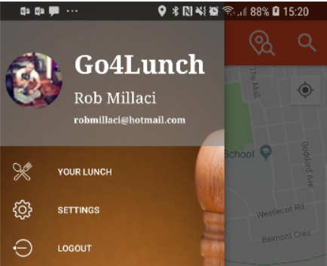
The Theme - Styles
This style was created in order to make the status bar invisible, this is so that we can meet material design requirements for the nav drawer menu
@style/AppThemeInvisibleStatusBar
<style name="AppThemeInvisibleStatusBar" parent="Theme.AppCompat.Light.DarkActionBar"> <item name="colorPrimary">@color/colorPrimary</item> <item name="colorPrimaryDark">@color/colorPrimaryDark</item> <item name="colorAccent">@color/colorAccent</item> <item name="android:actionMenuTextColor">@android:color/white</item> <item name="coordinatorLayoutStyle">@style/Widget.Design.CoordinatorLayout</item> <item name="windowActionBar">false</item> <item name="windowNoTitle">true</item> <item name="android:windowTranslucentStatus">true</item> </style>

Slide 19
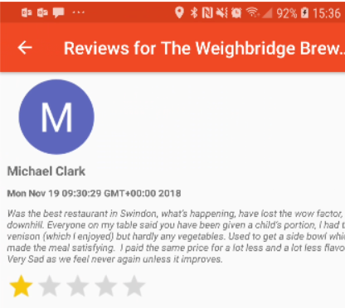
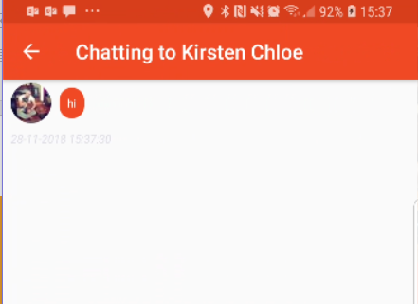
The Theme - Styles
This style has a visible status bar with an action bar. This is used in the chat activity and reviews activity. These activities don't contain a nav drawer but have an action bar to display the title text as well as a home button
@style/AppThemeVisibleStatusBarWithActionBar
<style name="AppThemeVisibleStatusBarWithActionBar" parent="Theme.AppCompat.Light.DarkActionBar"> <!-- Same as standard AppTheme but without translucent status bar --> <item name="colorPrimary">@color/colorPrimary</item> <item name="colorPrimaryDark">@color/colorPrimaryDark</item> <item name="colorAccent">@color/colorAccent</item> <item name="android:actionMenuTextColor">@android:color/white</item> <item name="coordinatorLayoutStyle">@style/Widget.Design.CoordinatorLayout</item> </style>

Slide 20
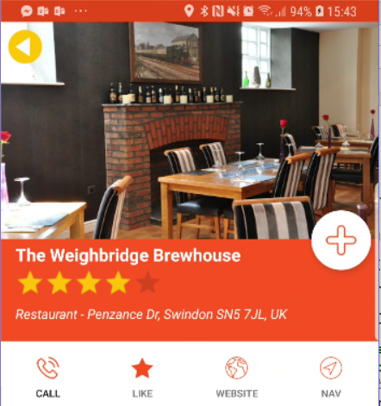
The Theme - Styles
This style has a visible status bar but doesn’t have an action bar. This is used in the restaurant activity, it gives more space to the activity and as we have no requirement to display any text or menu items, this activity looks better without an action bar
@style/AppThemeVisibleStatusBarNoActionBar
<style name="AppThemeVisibleStatusBarNoActionBar" parent="Theme.AppCompat.Light.DarkActionBar"> <!-- Same as standard AppTheme but without translucent status bar --> <item name="colorPrimary">@color/colorPrimary</item> <item name="colorPrimaryDark">@color/colorPrimaryDark</item> <item name="colorAccent">@color/colorAccent</item> <item name="android:actionMenuTextColor">@android:color/white</item> <item name="coordinatorLayoutStyle">@style/Widget.Design.CoordinatorLayout</item> <item name="windowActionBar">false</item> <item name="windowNoTitle">true</item> </style>

Slide 21
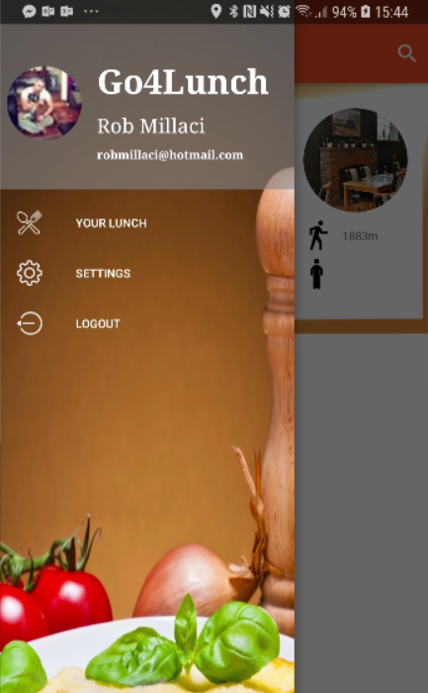
Navigation display
navName.setText(StartActivity.loggedInUser);
navEmail.setText(StartActivity.loggedInEmail);
Picasso.get().load(StartActivity.loggedInPic).into(navPic);
When the user is logged into the application 3 static variables are assigned that hold the users name, email and picture url.
When we create the main activity and defined the nav menu, we set the navName, navEmail and navPic views with these 3 values

Slide 22
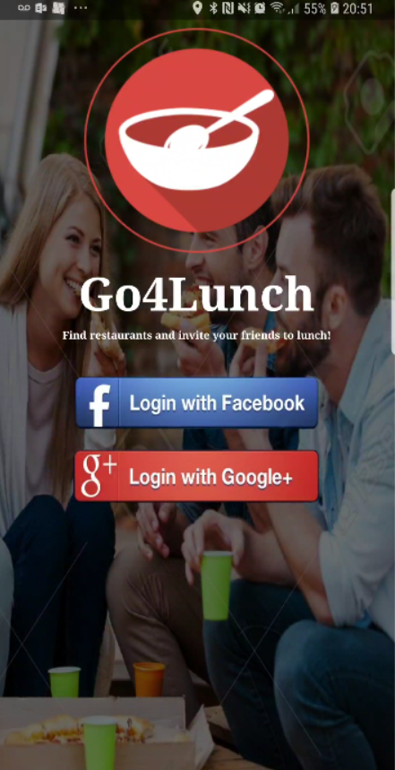
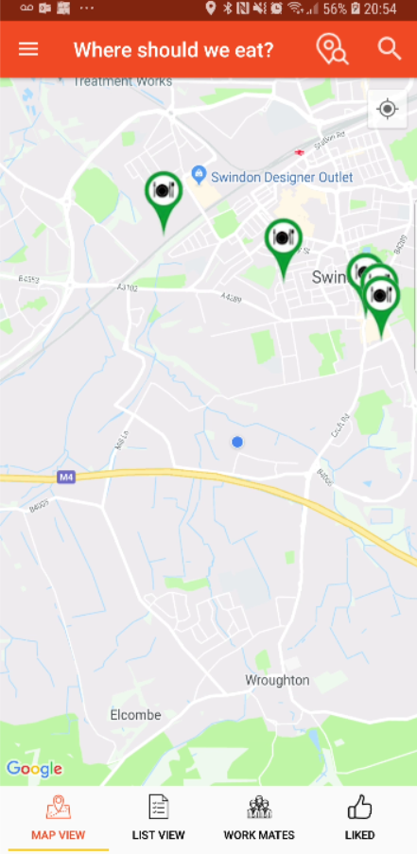
Using the app – Log in
When the user opens the app for the first time they are presented with the log in screen. They have the ability to log in via Facebook or with their google account. Once logged in they will be taken to the main activity with the google maps fragment being displayed

Slide 23
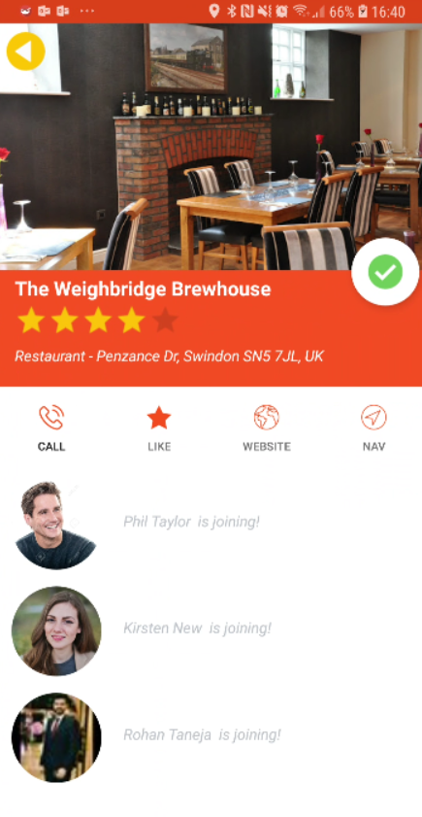
Markers
The app will display markers for places near the users location, markers for the place the user has selected for lunch as well as markers for places selected by those users in their friends list.
Each marker can be clicked to display detailed information of the place as well as which friends are eating there

Slide 24
Restaurant detail activity
From the restaurant detail page the user can perform a number of actions
The user can select this place to eat at
A number of actions are available; call,
like, view the website and launch navigation
Any of the users friends that have also selected this place are shown here

Slide 25
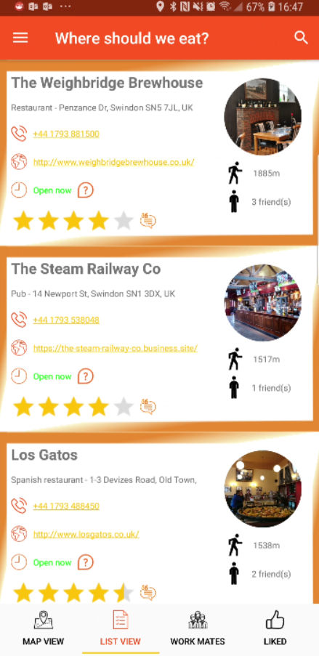
Restaurant list
The list view fragments shows the details of each marker added to the map
The name of the place as well as address
Image of the place
The distance from the current users location
The number of friends also eating here
The places phone number
The places email
Whether it is open or closed
The rating

Slide 26
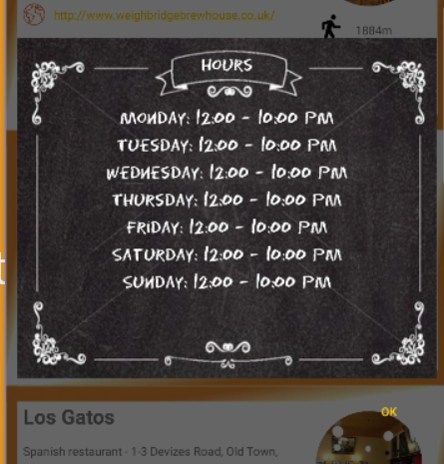
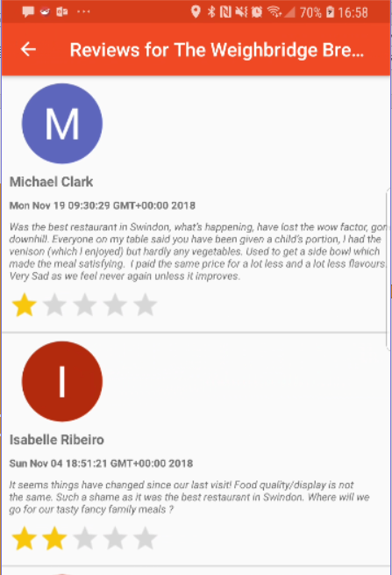
Restaurant list actions
There are two additional actions available to the users from the list page
Clicking on the ? Near the opening information displays more detail
Clicking on the icon next to the rating takes the user to the reviews activity

Slide 27
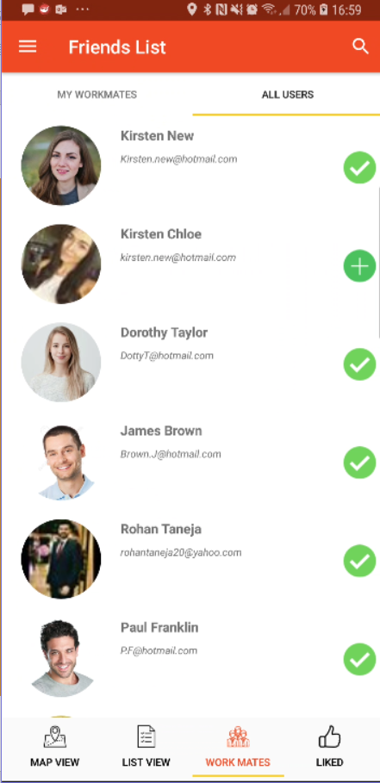

Friends List
The work mates tab contains 2 sub tab
All users – displays all users in the database
My Workmates –displays those users who have been added as friends
Clicking the adds the user to the friends list.
This added users place details are then available on the map and list view

Slide 28
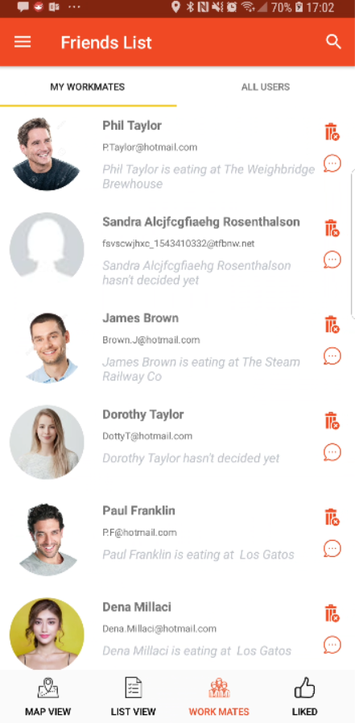
Friends List
From the ‘My workmates’ (friends) tab the user can see information about where a particular friend has chosen to eat.
There are also 2 actions that the user can take here
Clicking the will remove the friend
Clicking will launch the chat activity with this user

Slide 29
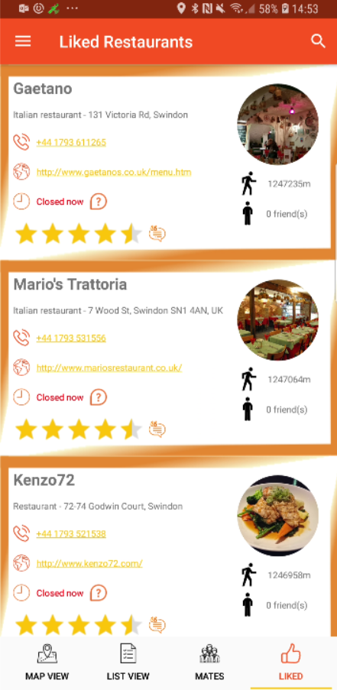
Liked tab
The final tab is “Liked”
This behaves similarly to the List view tab but displays any places the user has liked.
Regardless if the place appear on the map or not, these liked places will remain in the list until the user remove them

Slide 30
Search Functionality
Each tab has a specific search functionality
Friends List – the search will filter the list of users on either the ‘All users’ subtab or the ‘My workmates’ subtab
The filter will look at both name and email
List view and Liked - the search on these tabs will search through the restaurant name, address and type to enable a user to quickly find a place

Slide 31
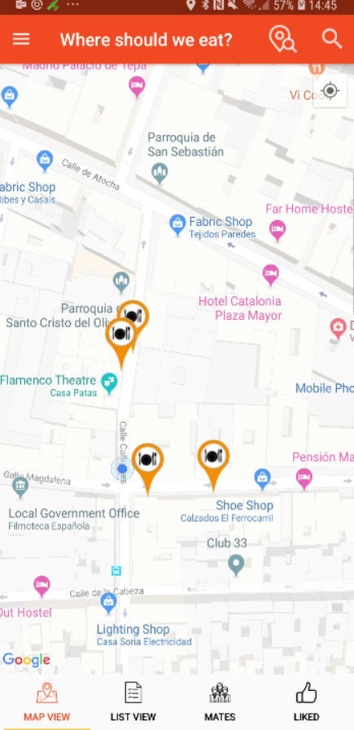
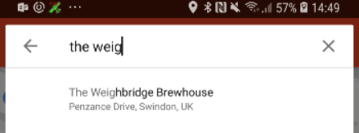
Search Functionality - Map
The maps fragment contains 2 search options
This search bring up Google autocomplete search
The user can search for any place and clicking on the place name will add it to the map with a marker that behaves like all other markers
This search acts as a marker filter, any markers currently on the map will be displayed/hidden based on the search criteria

